Slide 1
Database Normalization
Database normalization is a systematic process used in relational database design to organize data efficiently by dividing large, complex tables into smaller, related tables. The main motive of this is to confirm redundancy of data (duplicate data) is minimal and unwanted attributes such as insertion, update and deletion anomalies are avoided. Normalization does this through a set of rules known as the normal forms each having distinct requirements that narrow down how the database would be designed.
https://www.geeksforgeeks.org/dbms/introduction-of-database-normalization/
https://www.digitalocean.com/community/tutorials/database-normalization

Slide 2
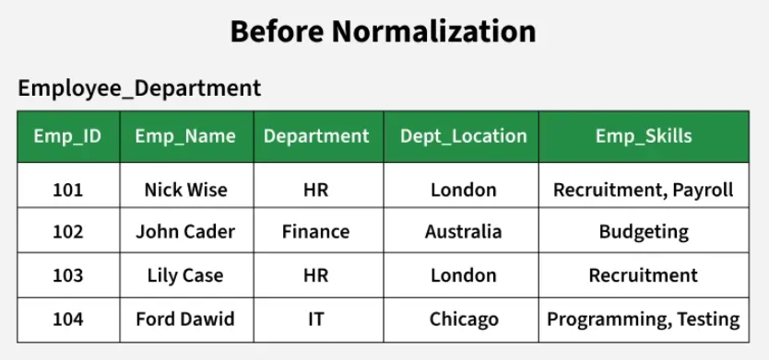
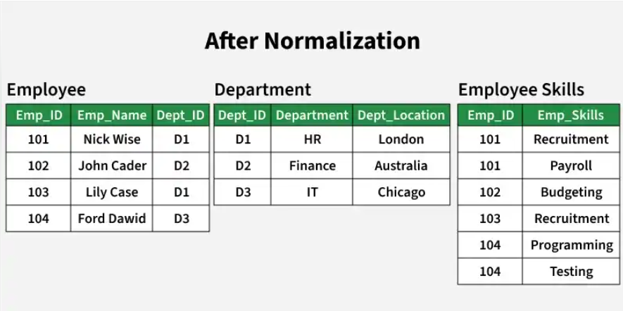

Slide 3
Objectives of Database Normalization
Eliminate Data Redundancy:
By breaking data into logical tables and removing duplicate information, normalization helps us make sure that each piece of data is stored only once. This reduces storage requirements and prevents inconsistencies.
Confirming Data Integrity:
Normalization enforces data consistency by establishing clear relationships and dependencies between tables. This maintains accurate and reliable data throughout the database.

Slide 4
Prevent Anomalies
Proper normalization prevents common data anomalies:
Insertion Anomalies:
Insertion anomalies occur when it is not possible to insert data into a database because the required fields are missing or because the data is incomplete. For example, if a database requires that every record has a primary key, but no value is provided for a particular record, it cannot be inserted into the database.
Deletion anomalies:
Deletion anomalies occur when deleting a record from a database and can result in the unintentional loss of data. For example, if a database contains information about customers and orders, deleting a customer record may also delete all the orders associated with that customer.

Slide 5
Update anomalies:
Update anomalies occur when modifying data in a database and can result in inconsistencies or errors. For example, if a database contains information about employees and their salaries, updating an employee’s salary in one record but not in all related records could lead to incorrect calculations and reporting.
Optimize Query Performance:
Well-structured tables can improve the efficiency of queries, especially for updates and maintenance, by reducing the amount of data processed.

Slide 6
First Normal Form (1NF)
is the initial stage in the process of database normalization. It ensures that each column in a table contains only atomic, indivisible values, and that each row is uniquely identifiable. By removing repeating groups and multi-valued attributes, 1NF lays the groundwork for a more organized and consistent database structure. This makes querying, updating, and maintaining data more efficient and reliable, and it helps avoid redundancy right from the beginning of database design.
Key Requirements:
-All columns contain atomic values (no lists, sets, or composite fields).
-Each row is unique (typically enforced by a primary key).
-No repeating groups or arrays within a row.
-Each column contains values of a single data type.

Slide 7


Slide 8
Why is this not in 1NF?
-Non-atomic values: “Purchased Products” contains multiple items per cell.
-Querying and updating are complex: Searching for customers who bought “Mouse” requires string parsing.
-Data integrity risks: No way to enforce referential integrity between products and customers.
-Inconsistent data entry: Different delimiters or typos can creep in.

Slide 9
Real-World Issues:
Reporting challenges:
Generating reports such as “How many customers bought a Laptop?” becomes complicated, as you cannot simply filter a column for “Laptop”, you must parse the string.
Update anomalies:
If a product name changes (e.g., “Mouse” to “Wireless Mouse”), you must update every occurrence in every cell, increasing the risk of missing some entries.
Data integrity risks:
There is no way to enforce referential integrity between products and customers, which can lead to orphaned or inconsistent data.

Slide 10
Summary:
This unnormalized table structure is easy to read for small datasets but quickly becomes unmanageable and unreliable as the amount of data grows. To comply with First Normal Form (1NF), we must ensure that each field contains only a single value, and that the table structure supports efficient querying, updating, and data integrity.

Slide 11
Transformation Steps to Achieve 1NF:
Identify columns with non-atomic values: In this case, “Purchased Products” contains multiple values.
Split the multi-valued column into separate rows: Each product purchased by a customer should be represented as a separate row, ensuring that every field contains only a single value.

Slide 12
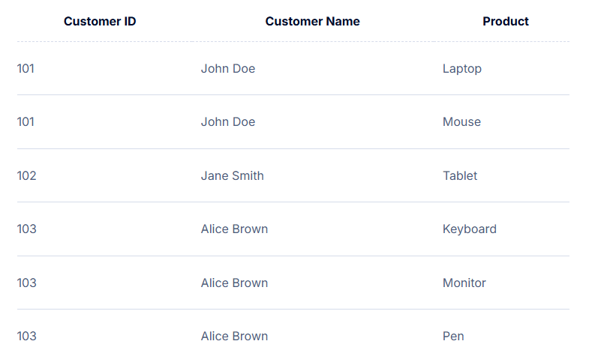
Explanation:
Each row now represents a single product purchased by a customer.
All columns contain atomic values (no lists or sets).
The table can be easily queried, updated, and maintained. For example, finding all customers who purchased “Mouse” is now straightforward.

Slide 13
Second Normal Form (2NF)
Definition:
A table is in 2NF if it is in 1NF and every non-prime attribute (i.e., non-primary key attribute) is fully functionally dependent on the entire primary key. This addresses partial dependencies, where a non-key attribute depends only on part of a composite key.

Slide 14
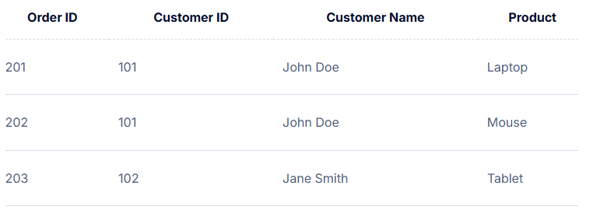
Issue:
“Customer Name” depends only on “Customer ID”, not the full primary key (“Order ID”, “Customer ID”). This is a partial dependency.
Normalization to 2NF:
Separate customer information into its own table.

Slide 15
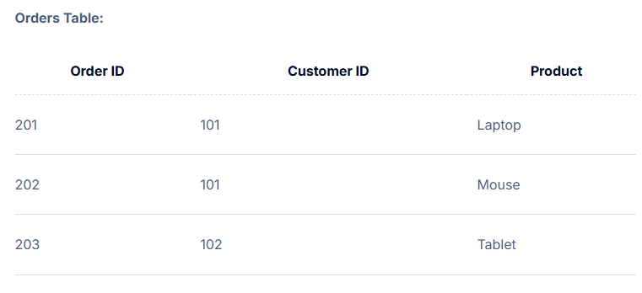
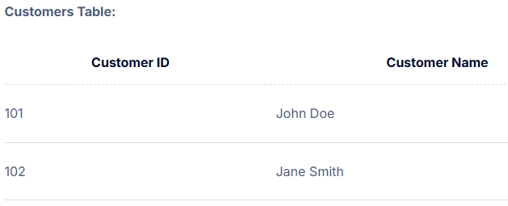
Benefits:
Eliminates redundancy of customer details.
Simplifies data maintenance and updates.
By moving CustomerName into a separate Customers table, we ensure it’s only dependent on CustomerID and eliminate partial dependency on a composite key.

Slide 16
Third Normal Form (3NF)
Definition:
A table is in 3NF if it is in 2NF and all the attributes are functionally dependent only on the primary key, there are no transitive dependencies (i.e., non-key attributes depending on other non-key attributes).

Slide 17
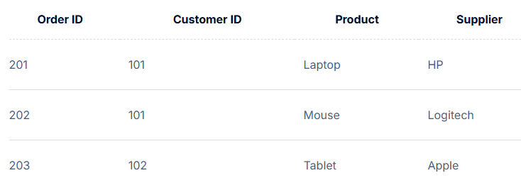
Issue:
“Supplier” depends on “Product”, not directly on the primary key.
Normalization to 3NF:
Move product and supplier information to separate tables.

Slide 18
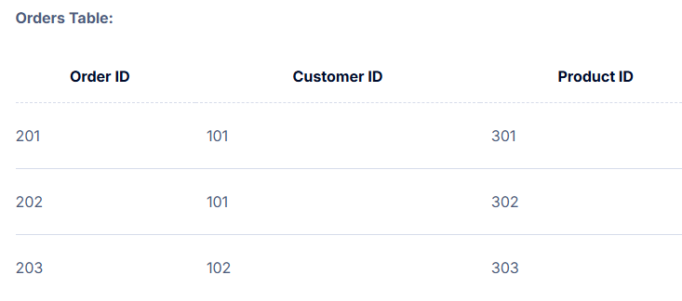
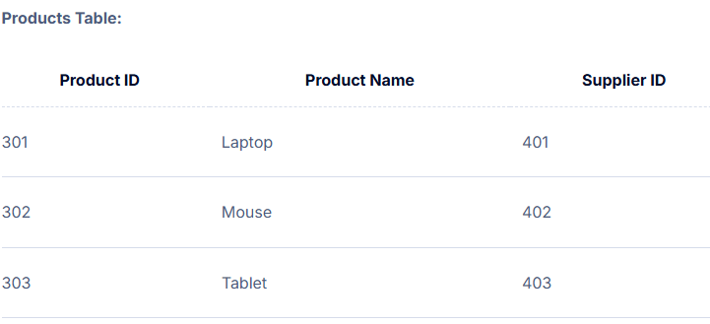
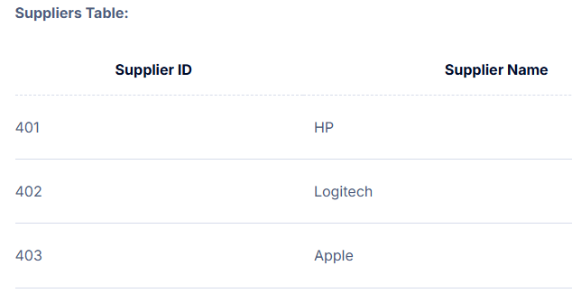
Since Supplier depends on Product and not directly on the primary key (OrderID), we isolate it into a new Suppliers table and reference it via the Products table. This removes transitive dependencies and aligns with 3NF rules.

